Slide 1




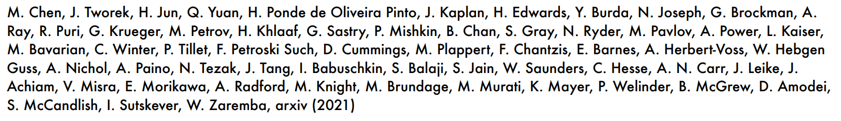
Evaluating Large Language Models Trained on Code
Presented by: David Aslanyan and Michael Kulikov

Slide 2



Introduction and Study Focus
The need for program synthesis and the evaluation of generated-sample-correctness
GPT models can generate code standalone Python functions from docstrings
Automatic Evaluation of the correctness of generated Python code samples from docstrings
Performance comparison between Codex with GPT-3 and GPT-J

Slide 3
Background: Language Models for Code
NLP models:
Self-supervised language modelling objectives have been adapted for code:
Language models such as GPT-J-6B have demonstrated promising code generation

Slide 4

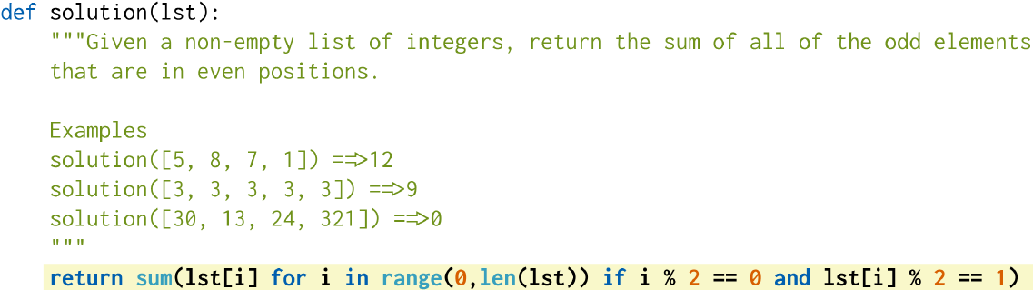
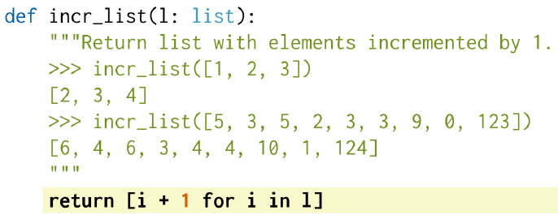
Task: Functions from Docstrings
This work focuses on Codex (GPT specialised for code):
Early analysis suggested GPT-3 could generate programs from Python docstrings
This was despite the fact that GPT-3 was not trained for code generation
Hypothesis: specializing a GPT language model for code could work across many tasks
Task:
Input as docstring → output as Python code

Slide 5

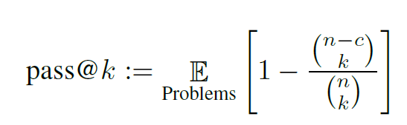
Evaluation Framework
Functional Correctness by using of the pass@k metric:
HumanEval Dataset- handwritten evaluation set of 164 programming problems:
Each problem includes: function signature, docstring, body, unit tests ( ~7.7 per problem)
Assesses simple mathematics, reasoning and language comprehension

Slide 6
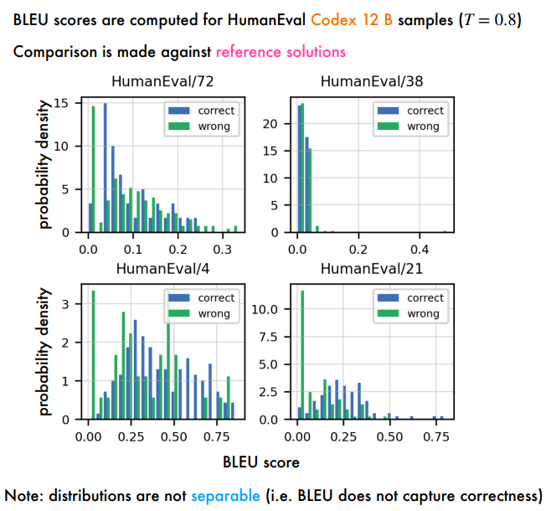
BLEU Score
BLEU (bilingual evaluation understudy) - algorithm for evaluating quality of text which has been machine-translated from one natural language to another
Temperature - is a parameter that influences the language model's output, determining whether the output is more random and creative or more predictable

Slide 7
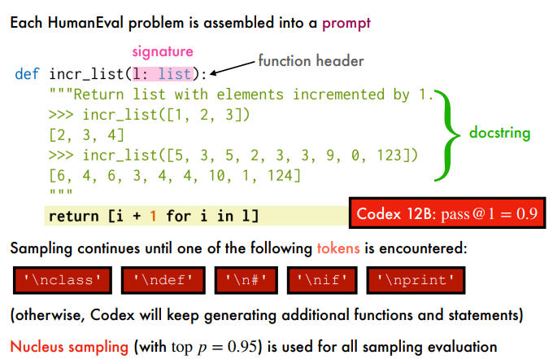
Example: Prompting for Evaluation
function header - function signature
docstring - code’s goal example\description
body - code implementation

Slide 8
Code Fine-Tuning
Fine-tuning GPT-3 would be appear to be useful (evaluated on prompts)
Fine-tuning from GPT-3 gave no improvement vs training from scratch:
may be a consequence of the large scale of the training corpus from GitHub
since fine-tuning from GPT-3 converges faster, it is used for all experiments
For optimisation, Codex uses the same learning rate as corresponding GPT model
A total of 100 billion tokens are used for training

Slide 9

Training Dataset GitHub
Collecting Training Dataset from 54M public repositories on GitHub: 170GB of unique Python files under 1 MB
Filtered Training Dataset totaled 159 GB
Lexical Tokenization change as distribution of words in GitHub differs from natural language:
code lexer is based on GPT-3 tokenizer
extra tokens added to represent whitespace
30% fewer tokens than natural text

Slide 10
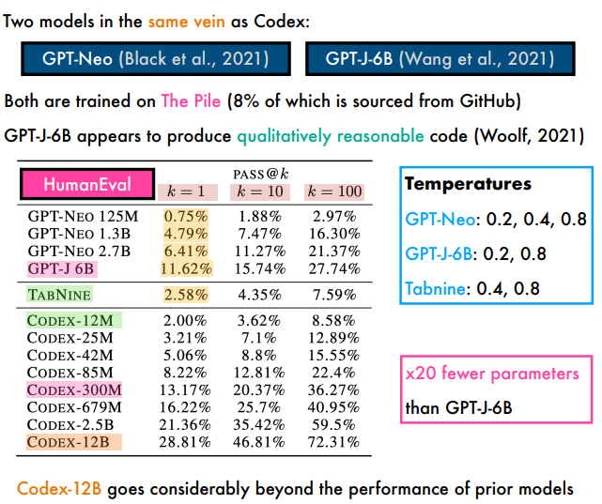
Comparative Analysis of
Related Models and Systems
The Pile - 825 GiB diverse, open source LM data set. Consists of 22 smaller, high-quality datasets combined.
Temperature - determines the likelihood of a model to come up with different options for the next word. Most LM’s temperature ranges between 0 to 1.

Slide 11
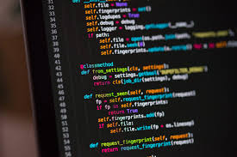
Supervised Fine-Tuning Codex-S
Supervised Fine-Tuning (Codex-S)
CI repository - automated integration of code changes from multiple contributors into a single software project.
sys.setprofile - a trace function that's triggered every time the VM enters or exits both Python and C functions.
Training set contains: data from sources with solutions to problems (continuous integration (CI) repositories, competitive programing websites), open source repositories
Unit tests:
Tests are usually hidden
Contain examples in problem statement
Traced integration with sys.setprofile (could return none, etc)
Excess files ( classes, config, scripts, data files etc)
Description misuse - problem descriptions as docstrings for task assembly
Code - Incorrect solutions, redundancy(Most of the code is not needed to generate code from docstrings. Reduces HumanEval )

Slide 12
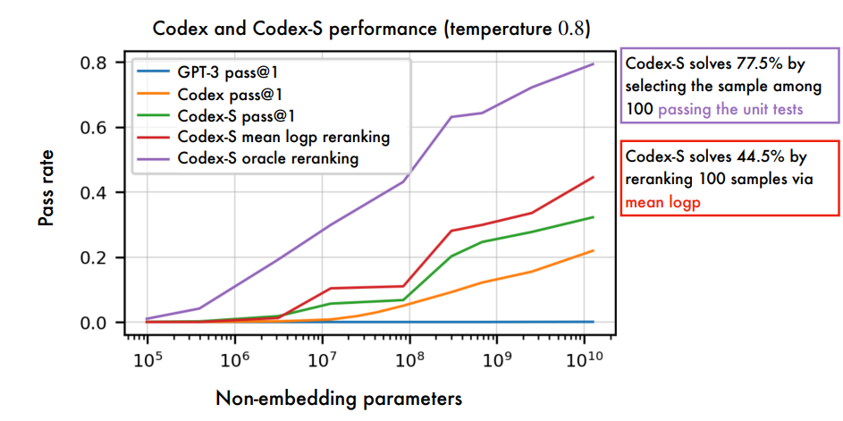
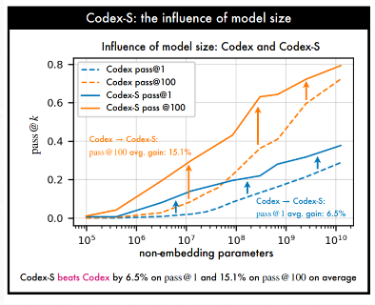
Supervised Fine-tuning: Results

Slide 13
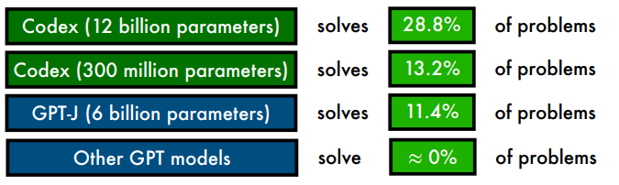
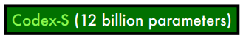
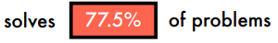
Problem-Solving Results
To solve a problem, generate samples and check if any pass the unit tests.
With one
sample:
After fine-tuning of Codex on correctly implemented functions:
With 100 samples:

Slide 14
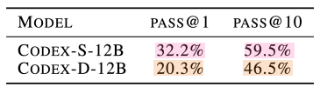
Docstring Generation (Codex-D)
Docstring generation is useful for safety: it can describe intent behind code.
A training dataset for docstring generation can be easily created
For each problem, concatenate: signature reference solution docstring
Codex-S is trained to minimise negative log-likelihood of reference solution
Codex-D is trained to minimise negative log-likelihood of docstring
Performance is better when generating code than generating docstrings
It is not clear a priori which direction should yield higher pass rates:
Docstrings may be more forgiving (natural language less strict than code)
Training docstrings may be of lower quality than code

Slide 15
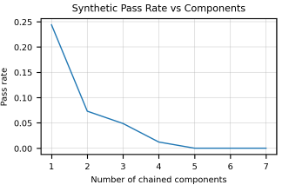
Limitations
Codex is unpredictable - could generate flawed or malicious code for certain prompts
Codex performance degrades as the docstring length and complexity increase
Codex training is not sample efficient.Training corpus contains hundreds of millions of lines of code from GitHub
A strong intro-level CS student would solve more problems than Codex
There remains a large gap in sample efficiency between Codex and humans

Slide 16

Bias Analysis
Codex tends to produce similar biases to GPT-3 but with less diversity
Biased prompts may lead to biased code
Codex can be prompted to generate racist, denigratory and harmful comments
Codex can generate code with structure that reflects stereotypes spanning: gender, race, emotion, class, the structure of names, other characteristics
Code generation models are not "objective" tools - they inherit from their training data

Slide 17

Summary
This work investigated the feasibility of training LLMs to generate code from docstrings
By fine-tuning GPT on code from GitHub, Codex performs well human-written problems ( comparable to easy interview problems)
Training on a distribution closer to evaluation and using multiple samples produces better performance (Codex-S)
Codex-D was also introduced to generate docstrings from code bodies (less strong, but comparable)

Slide 18

Thank You!

Slide 19
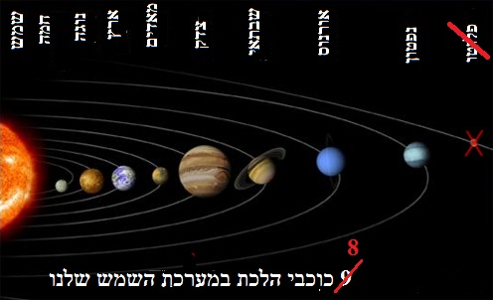
Class Activity
Given the following prompt, mark the mistakes you find. Look for grammar, factual or logical mistakes.
Input the prompt into ChatGPT, compare ChatGPT’s feedback with your identified mistakes. Note any mistakes you found that ChatGPT missed.
Share findings.
https://chatgpt.com/share/fc4f42f7-9717-4bc0-ba7e-fa4536f604ea

Slide 20
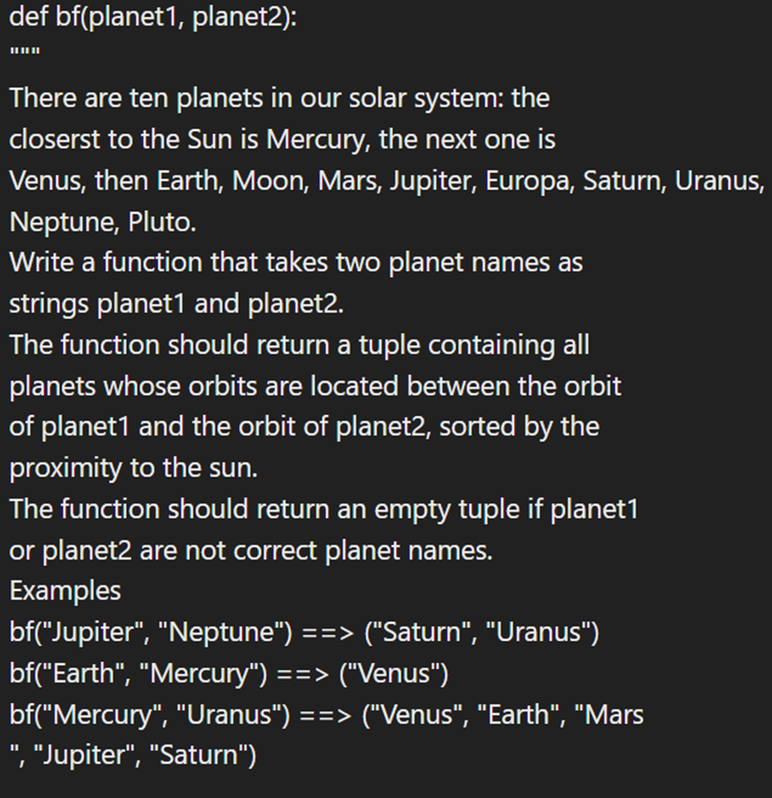
The Prompt!

Slide 21
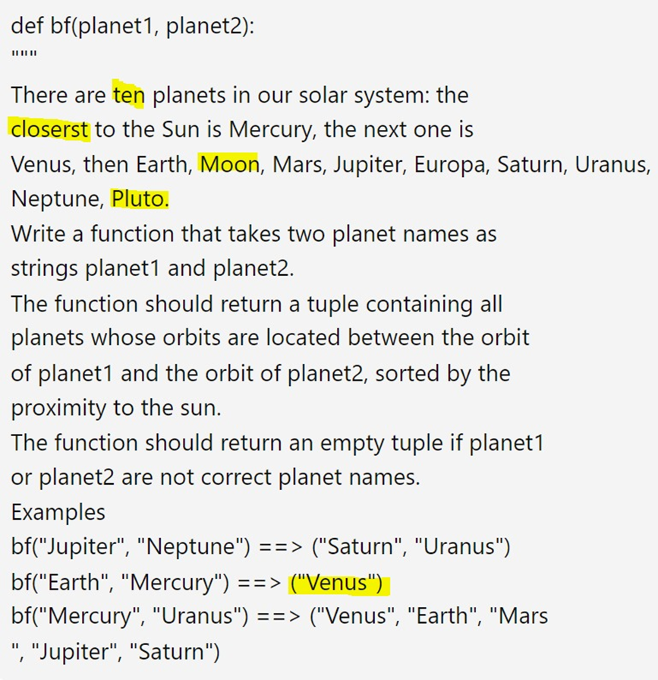
Mistakes

